Slide 1



Garbage Classification

Slide 2

Learning Objectives
Understand the problem of garbage classification and its importance in waste management and environmental conservation.
Learn how to apply transfer learning using a pre-trained Convolutional Neural Network (CNN) architecture (EfficientNetV2B2) for image classification.
Explore techniques for handling dataset imbalance, such as calculating and using class weights.
Understand the role and implementation of callbacks like Early Stopping and Model Checkpointing in training deep learning models.
Learn how to preprocess image data, including data augmentation, for training robust models.
Evaluate the performance of an image classification model using metrics like accuracy, precision, recall, F1-score, and confusion matrices.
Gain experience in building a simple interactive web interface (using Gradio) to demonstrate a trained machine learning model.
GOAL
Source :
www.freepik.com/

Slide 3
Tools and Technology used
Programming Language: Python
Deep Learning Frameworks: TensorFlow, Keras
Libraries: NumPy, Matplotlib, Seaborn, Scikit-learn, Gradio
Model Architecture: EfficientNetV2B2 (pre-trained CNN)
Development Environment: Google Colab

Slide 4
Methodology
Data Collection and Preparation:
Gathered a dataset of garbage images categorized into different types (e.g., cardboard, glass, metal, paper, plastic, trash).
Loaded and explored the dataset, including visualizing sample images and checking class distribution.
Split the dataset into training, validation, and test sets.
Data Preprocessing and Augmentation:
Resized images to a consistent input size for the model.
Applied data augmentation techniques (e.g., random flips, rotations, zooms) to the training data to increase dataset size and improve model generalization.
Configured datasets for performance using caching and prefetching.
Model Building (Transfer Learning):
Utilized the pre-trained EfficientNetV2B2 model as a base.
Froze the base model's layers to leverage learned features.
Added custom layers (GlobalAveragePooling2D and a dense output layer) for the classification task.

Slide 5
Handling Class Imbalance:
Calculated class weights based on the distribution of images in the training set.
Incorporated class weights during model training to give more importance to underrepresented classes.
Model Training:
Compiled the model with an appropriate optimizer (Adam) and loss function (categorical crossentropy).
Trained the model on the augmented training data.
Used Early Stopping to monitor validation loss and stop training when performance plateaus.
Used Model Checkpointing to save the best model based on validation loss.
Model Fine-tuning (Optional):
Unfroze a few top layers of the base model.
Retrained the model with a lower learning rate to fine-tune the pre-trained weights on the specific garbage dataset.
Model Evaluation:
Evaluated the trained model on the unseen test set.
Assessed performance using metrics like accuracy, loss, precision, recall, F1-score, and a confusion matrix.

Slide 6
Problem Statement:
Inefficient manual sorting of garbage leads to low recycling rates and increased landfill waste.
There is a need for an automated system to accurately classify different types of trash to improve waste management and recycling efforts.
Developing an accurate and efficient image classification model for diverse garbage categories is challenging due to variations in appearance, lighting, and potential dataset imbalances.

Slide 7
Solution:
A deep learning model based on EfficientNetV2B2 that can classify garbage images into predefined categories.
The model is trained using transfer learning and techniques to handle dataset imbalance for improved accuracy.
An interactive Gradio interface that allows users to upload garbage images and get real-time classification predictions.
The trained model can be exported for deployment in various waste management systems.

Slide 8
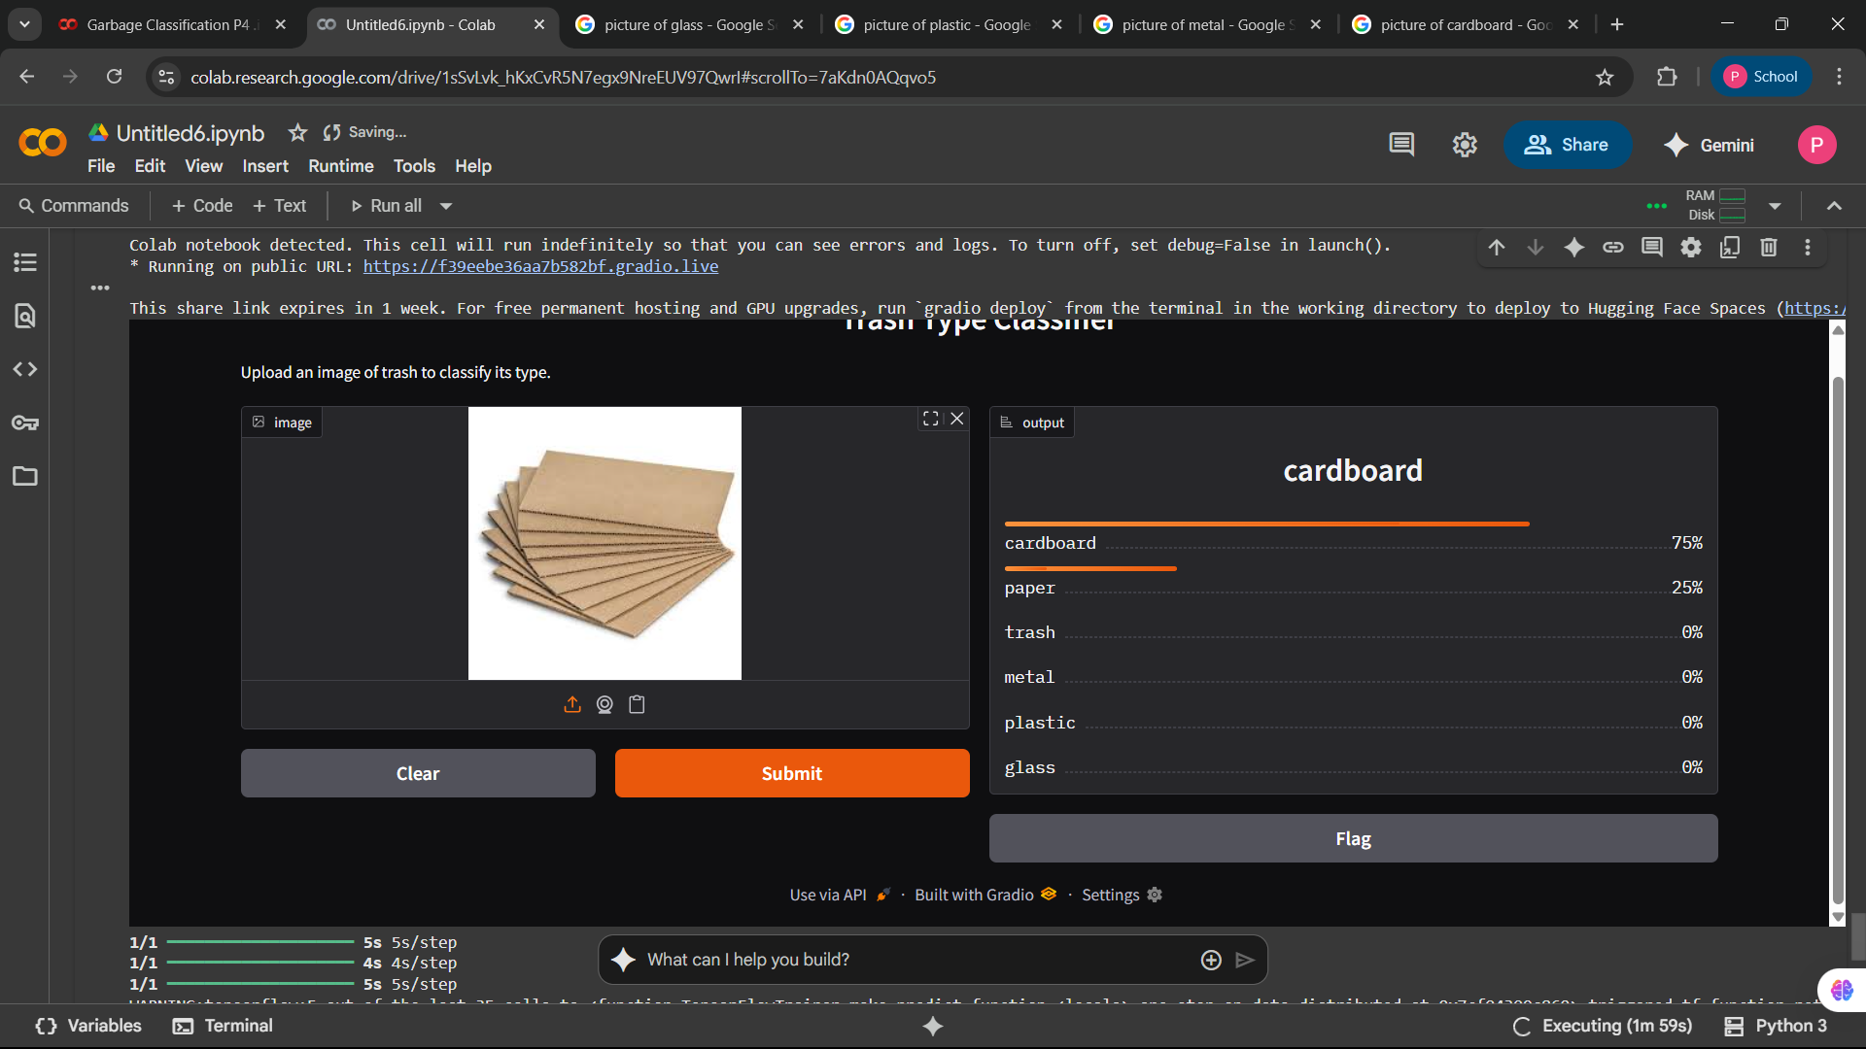
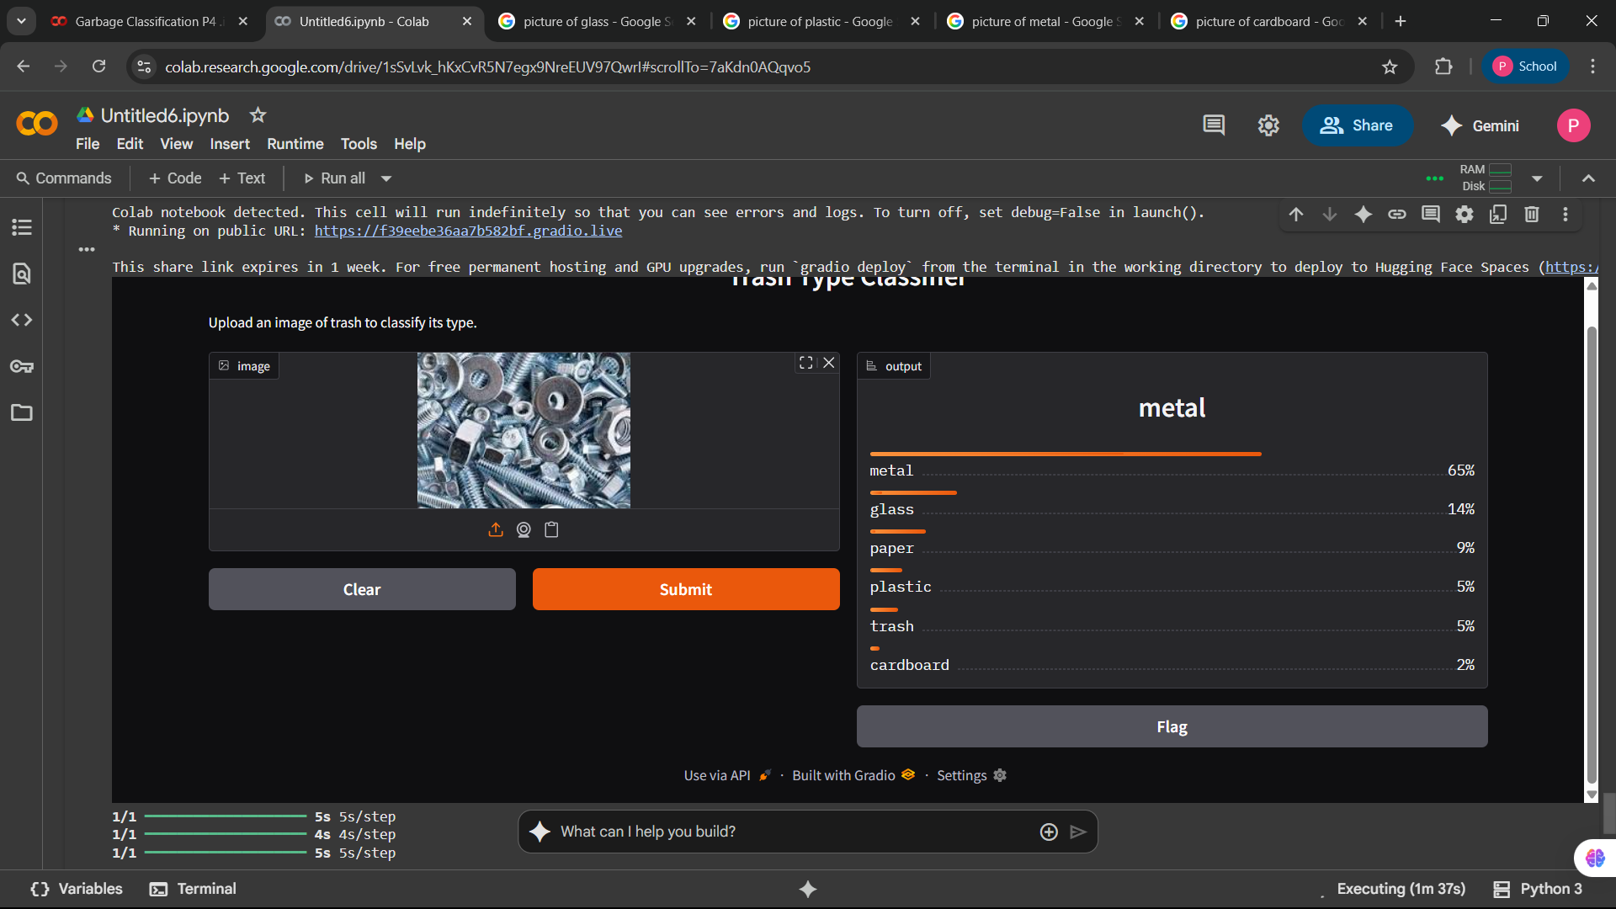
Screenshot of Output:

Slide 9
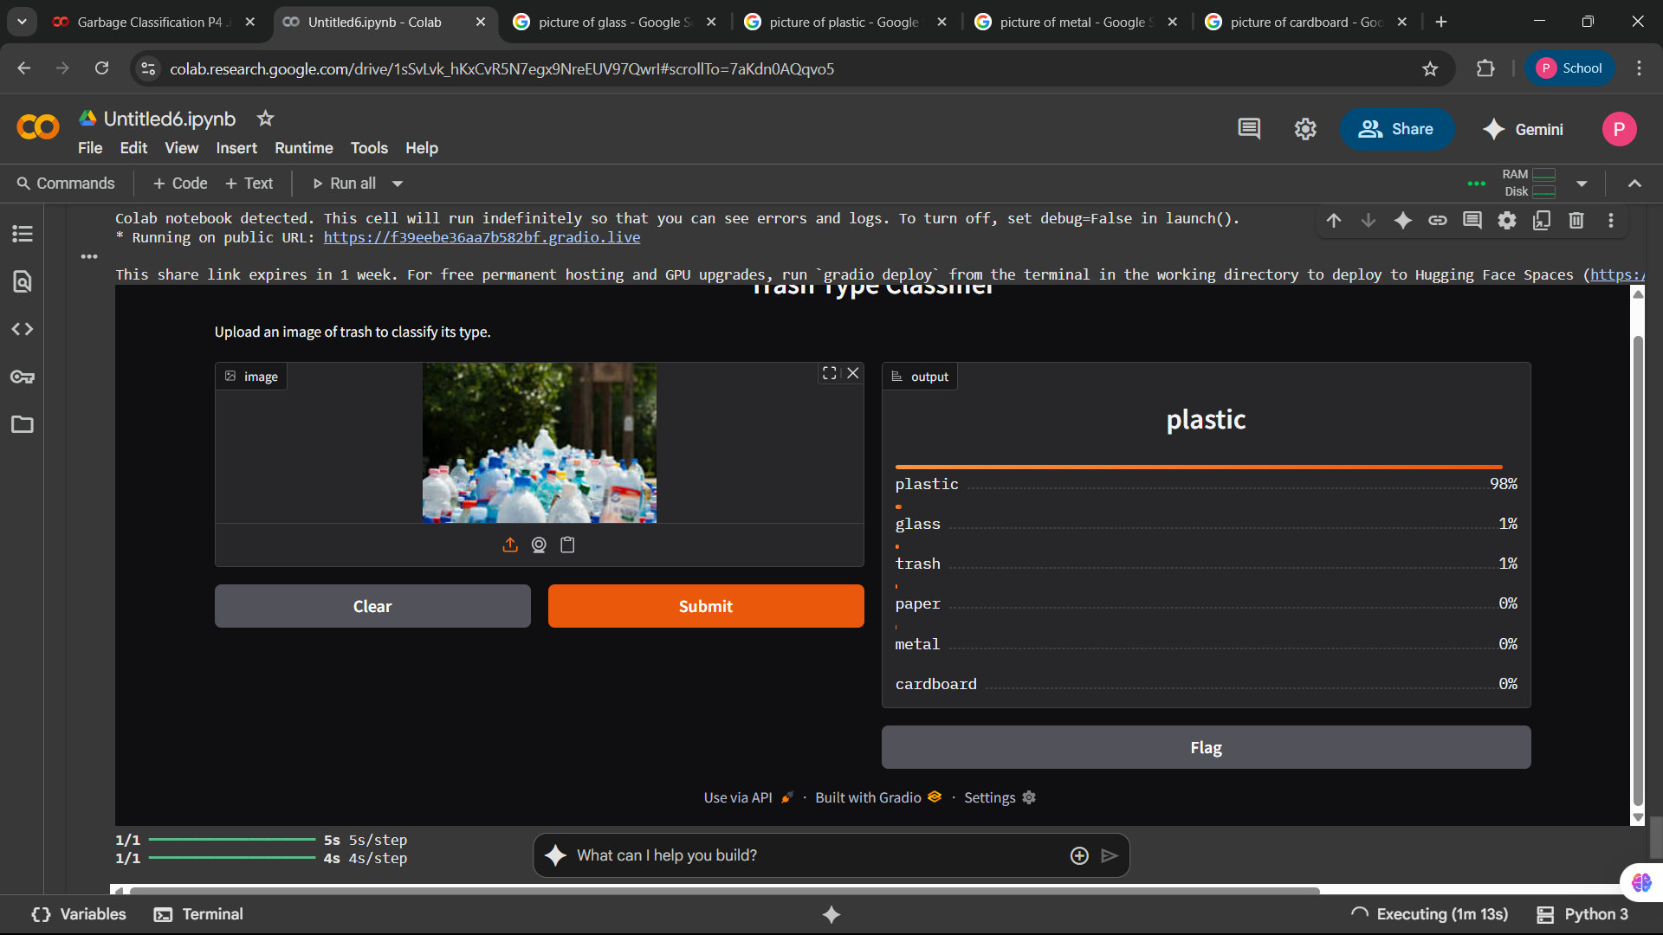
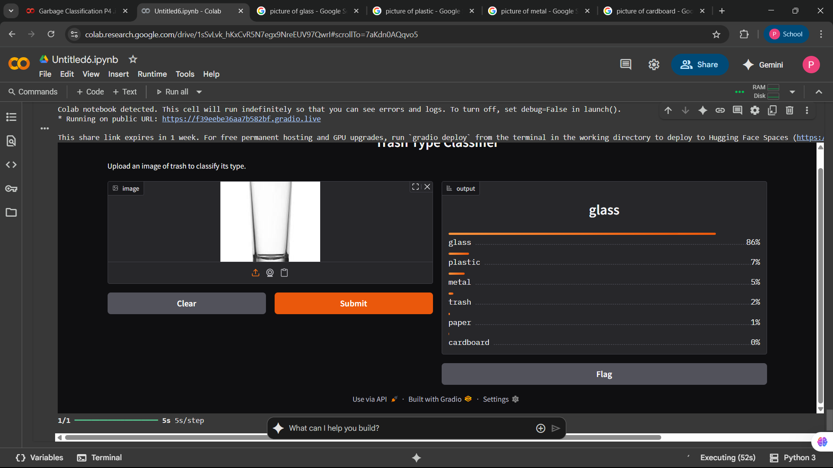

Slide 10
Conclusion:
The developed image classification model, utilizing a fine-tuned EfficientNetV2B2 base. The training process incorporated data augmentation, class weighting to address dataset imbalance, and callbacks such as Early Stopping, Model Checkpointing, and ReduceLROnPlateau for improved training stability and performance. The classification report and confusion matrix provided valuable insights into the model's performance across different trash categories, highlighting areas for potential improvement, particularly with the 'trash' class.

